Slide 1
Laureate Park Master Association HOA Informal Meeting February 13, 2024
Dockside | 6:00 to 7:30

Slide 2
MEETING AGENDA
Welcome and Introductions
Governance of HOA / CDD / Tavistock Management
New Laureate Park Phases and Roads
General Development Update
Q & A

Slide 3
LAUREATE PARK KEY CONTACTS
Artemis Lifestyles (HOA Management)
Michelle Arditi
Senior CAM marditi@artemislifestyles.com
Denise Burgos
CAM dburgos@artemislifestyles.com
Brenda Elliott
CAM belliott@artemislifestyles.com
Ileen Santiago
Junior CAM lsantiago@artemislifestyles.com
Tavistock Management (HOA + Laureate Park Aquatic and LP Fit)
Bryan Merced
Tavistock Homeowner Association Manager bryan.merced@tavistock.com
Lake Nona Information Center (For general Lake Nona information vs HOA)
Information Center Manager - Kelly McGinty Kmcginty@Tavistock.com

Slide 4
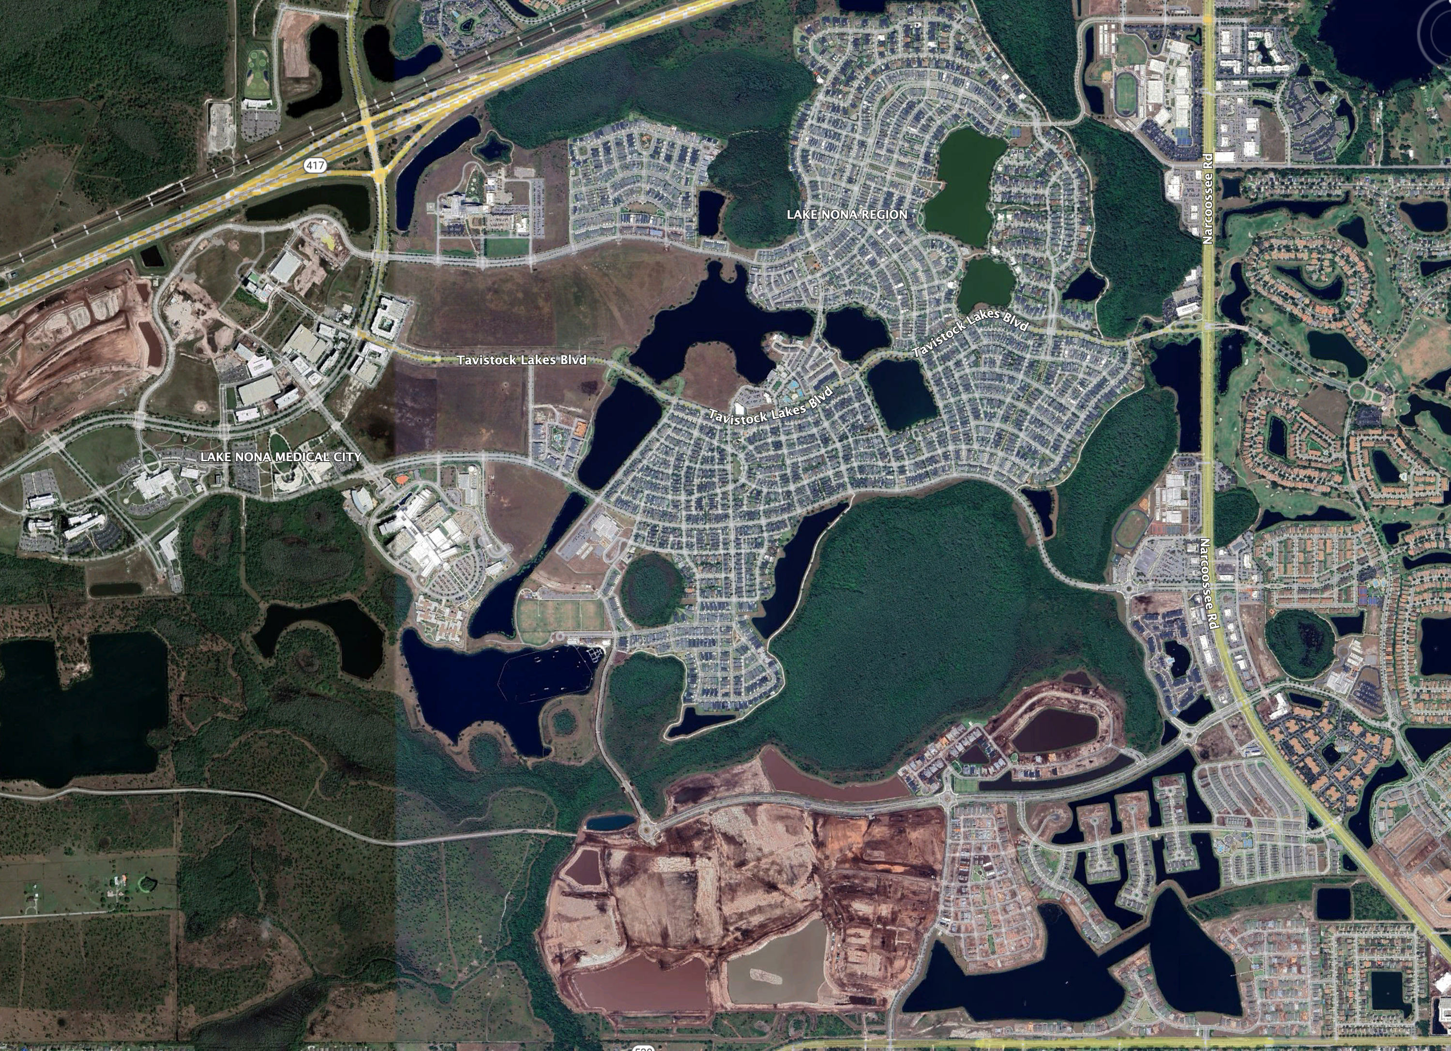
Laureate Park – Management Areas
Greeneway Park Improvement District
Tavistock Lakes Blvd
Laureate Blvd (except Phases 1A AND 1B)
Poitras East CDD
Luminary Blvd
Midtown Improvement District
Centerline Drive
NEMOURS PKWY
Tavistock Development
Commercial Property
Laureate Park Village Center
- Laureate Park Aquatic Center
- LP Fit
- Dockside
HOA Management
Community Parks
Common Area Maintenance
- Townhomes + Duplexes
TAVISTOCK LAKES BLVD
LAUREATE BLVD
LUMINARY BLVD
https://www.greenewayid.org
http://poitraseastcdd.com
LUMINARY BLVD

Slide 5
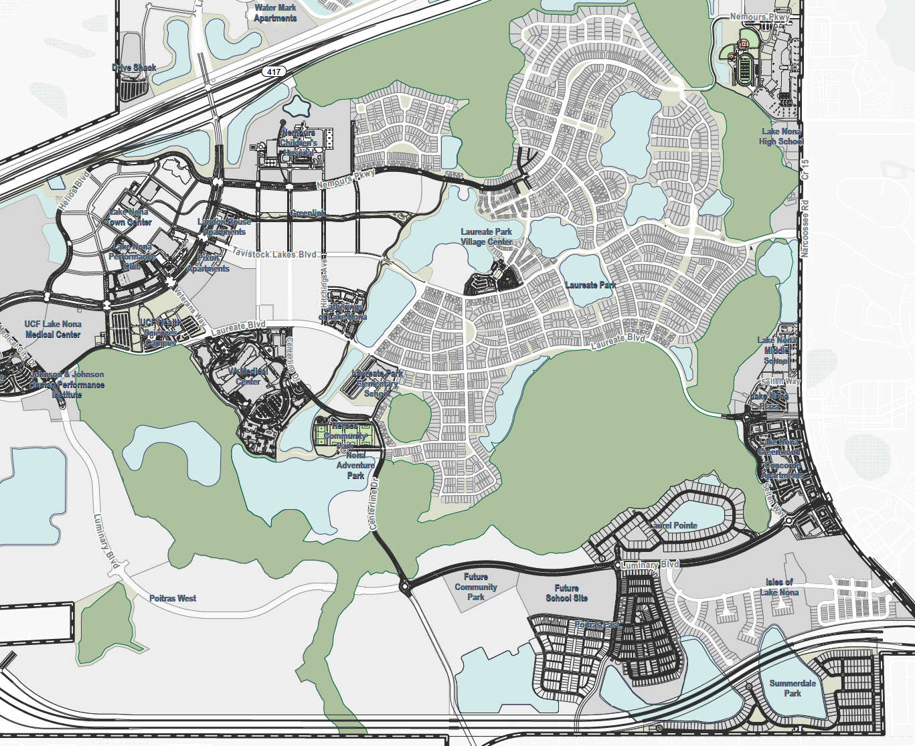
Laureate Park – Phase Map
NARCOOSSEE RD
Greeneway Park Improvement District
Tavistock Lakes Blvd
Laureate Blvd (except Phases 1A AND 1B)
Tavistock Development
Commercial Property
Laureate Park Village Center
- Laureate Park Aquatic Center
- LP Fit
- LakeHouse
HOA Management
Community Parks
Common Area Maintenance
- Townhomes + Duplexes
P-6
PHASE 6
P-8
P-9
P-10
P-3
P-7
NC1
P-5
P-2A
P-1
P-2B
P-4
N-4W
N-2(2)
N-2(1)
N-1
N-3

Slide 6
Development Updates
New Water Fountain Installs
New Community garden near Phase 10 in design
Lake Nona West (retail) announcements coming soon
New OCPS Middle School to open in August (Elementary School coming in ‘25)
City of Orlando Community Park in design phase

Slide 7
Water Fountains

Slide 8
New Community
Garden

Slide 9
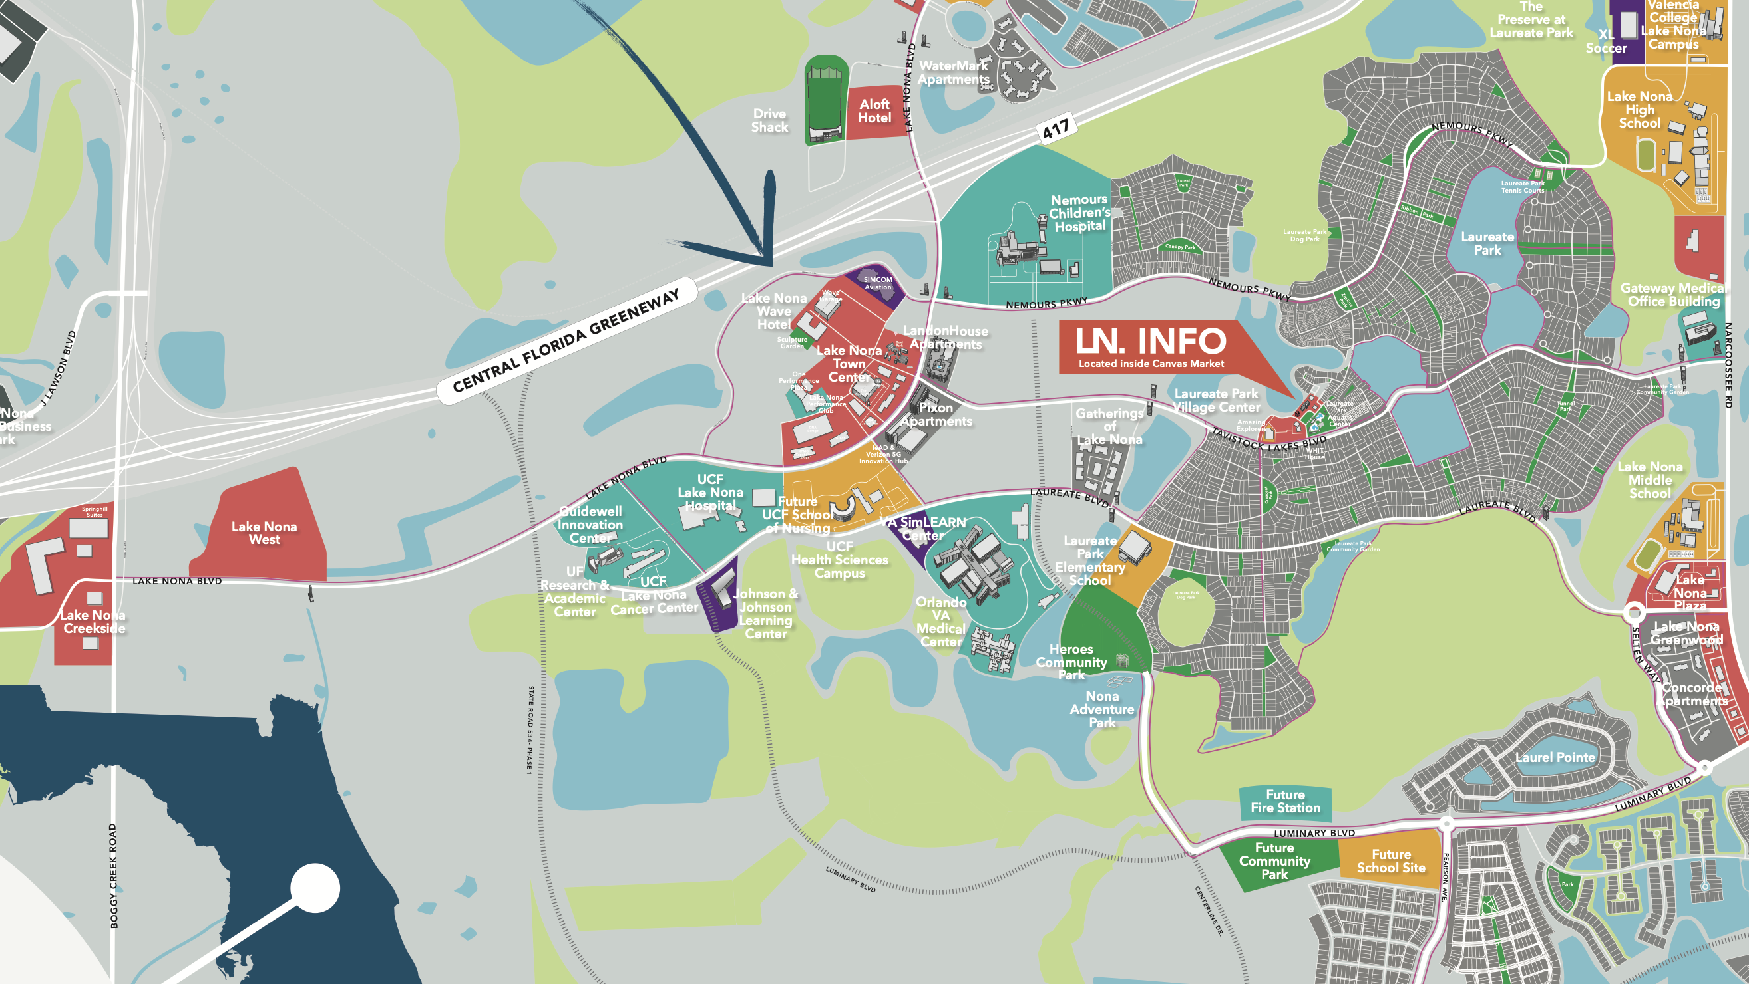

Slide 11
Q & A

